Slide 1
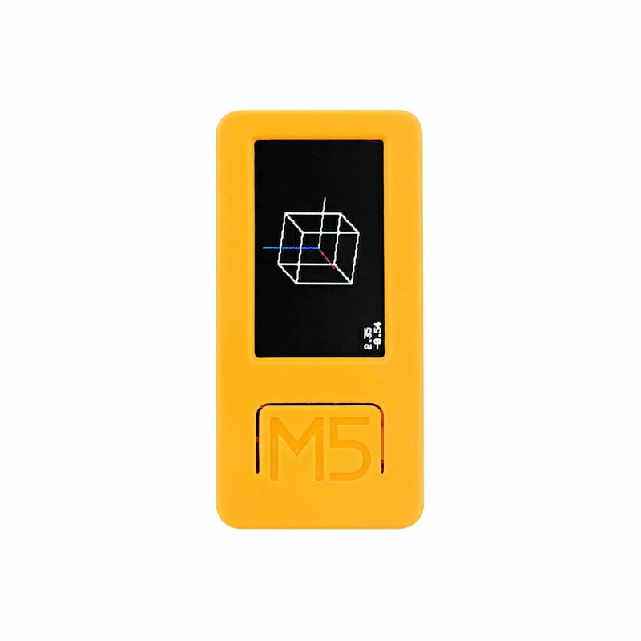
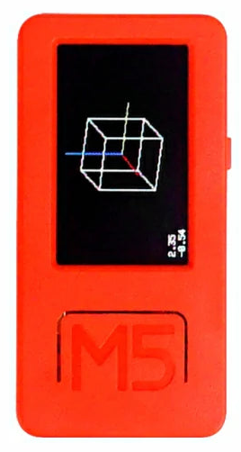
Getting to Know the M5StickCPlus1/2

Slide 2

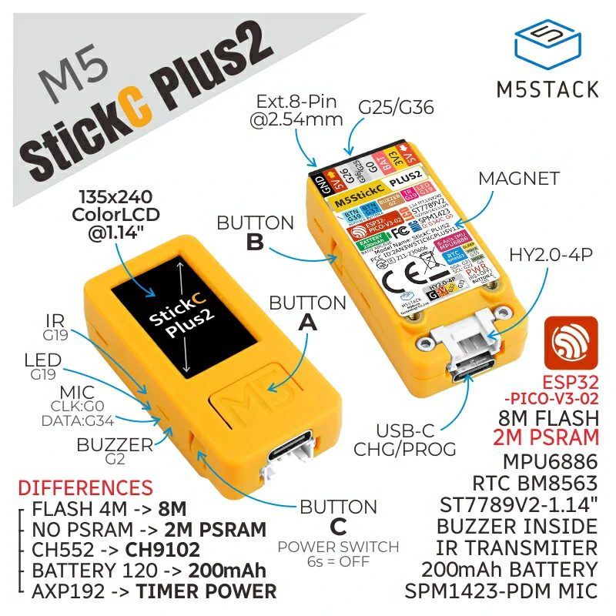
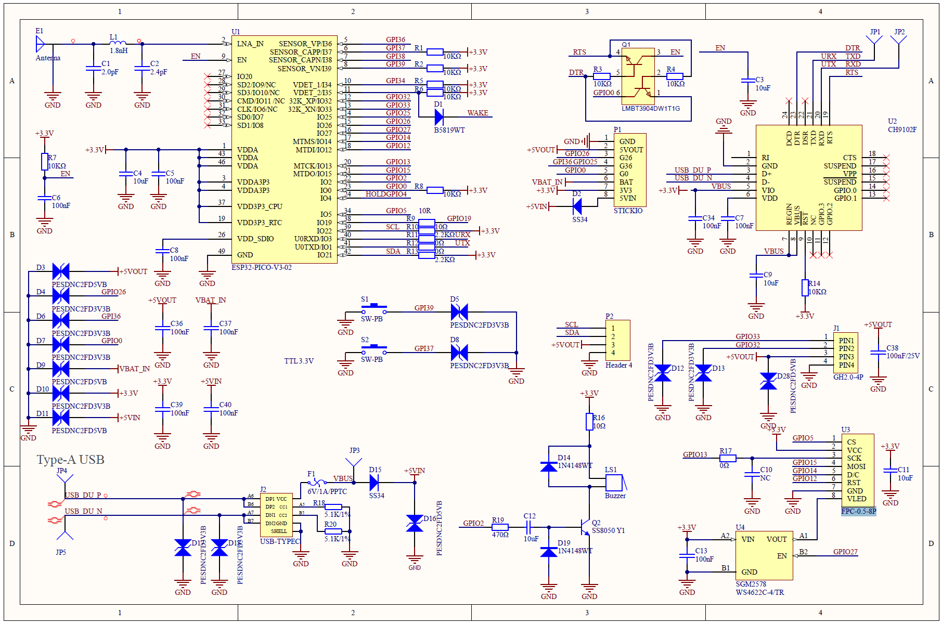
What is it?
Part Microcontroller – ESP32-PICO D4 or PICO-V3-02
Used to describe a processor intended to be used inside embedded systems, rather than general purpose computers.
This is the part that has WiFi/Bluetooth and Memory. Stores/Runs your code.
The M5StickCPlus2 is slightly better in general, but not for this class
Part Peripheral components connected to the microcontroller
Sensors
Accelerometer/Gyroscope (Inertial Measurement Unit)
Microphone
3 Buttons
Controllers
Power management
Real-time Clock for Low Power sleep modes
Outputs
Display
Buzzer (very quiet, loudest at 4000Hz)
IR Transmitter (for controlling TVs and other devices with receivers)
USB-Serial (how you program)
Part Enclosure
Protection
Headers for connecting additional components
Magnet inside for quick attachments
Full schematics available.

Slide 3

How do you program it?
Theoretically using ESPRESSIF toolchain
Compiles C++ code for its architecture the https://www.cadence.com/en_US/home/resources/datasheets/xtensa-lx7-processor-ds.html
Upload over USB using esptool.py (yes, python)
Practically – Arduino IDE
Massive library of code
Support from M5, including peripherals
For simple things – MicroPython

Slide 4
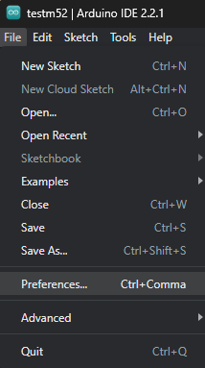
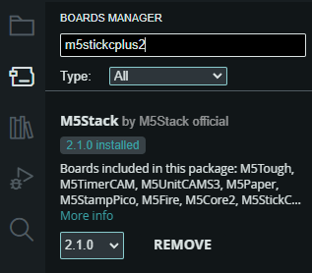
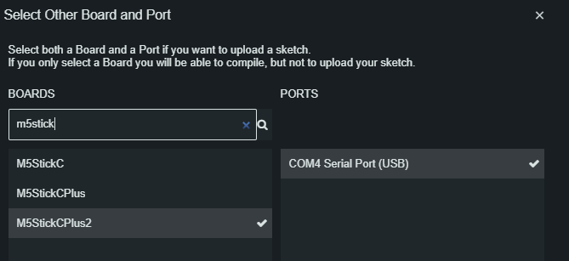
Getting it up and running
Install the Arduino IDE https://www.arduino.cc/en/software
Follow (Arduino) instructions at https://docs.m5stack.com/en/arduino/arduino_ide
M5StickCplus (orange one): https://docs.m5stack.com/en/arduino/m5stickc_plus/program
Or M5StickCplus2 (yellow one): https://docs.m5stack.com/en/arduino/m5stickc_plus2/program
May have to install a Serial port driver (on Windows, these are listed in device manager as COM ports, in Mac, terminal: ls /dev/tty.*)
M5StickCPlus must be on to be detected.
Basic steps once you have Arduino
Set preference for “Additional boards manager URLs”, and in Boards Manager, Install M5Stack
In Library Manager: Install the M5Unified library, which works for both the M5StickCPlus and M5StickCPlus2.
You could also install the more specific libraries for these devices, M5StickCPlus and M5StickCplus2, which have similar functionality (but will not work across the M5Stack library)
Restart Arduino IDE, Turn on and connect M5StickCPlus, & Tell Arduino which Board is connected to your serial port

Slide 5
Basic Arduino/C++
Similar in the way code executes to Python, with similar operators and expressions
Differences
Comments start with // or are enclosed with /* comment */
All variables and functions have an explicitly declared static type, which defines exactly how they are stored in memory or what type they return (in the case of functions)
int, float, char, char * (string), uint8_t (byte), int my_fun()
Programs work directly with memory addresses, and must actively manage any memory allocations (e.g., growing or shrinking lists)
statements end with a semicolon, not a new line, or use curly braces to indicate the body
if, for, while, functions, structs, classes use curly braces when they include multiple lines.
Arduino programs must have both void setup(){} and void loop(){} functions defined
void means no return value
These are compiled into a complete program that runs setup() once, and loop() repeatedly.

Slide 6
Simple Arduino Program
This will work with almost any Arduino-compatible microcontroller, including the M5StickCPlus
The purpose of the delay in setup is to ensure that you see it between the time you upload and the type you connect the serial port
115200 is an agreed upon “baud” rate for data transfer between devices connected via the serial port. The other device in this case is your computer, connected via USB.
int i = 0;
void setup() {
Serial.begin(115200);
delay(1000);
Serial.println("Hello World");
}
void loop() {
Serial.println(i);
i = i + 1;
if (i == 10) {
i = 0;
}
delay(1000);
}

Slide 7

Using M5Stick Functions
#include "M5Unified.h"
void setup() {
auto cfg = M5.config();
M5.begin(cfg);
M5.Display.setRotation(1);
M5.Speaker.setVolume(255);
}
void loop() {
M5.delay(1);
M5.update();
// Action when Button A is pressed
if (M5.BtnA.wasPressed()) {
M5.Display.println(" Hello World!");
M5.Speaker.tone(4000.0, 100);
}
// Action when Button A is held
if (M5.BtnA.wasHold()) {
M5.Display.setCursor(0, 0);
M5.Display.clear();
// Play tone: freq 4400Hz, 100ms duration, channel 0, stop current sound
M5.Speaker.tone(4400.0, 100, 0, true);
M5.Display.drawCenterString("cleared", M5.Display.width() / 2, M5.Display.height() / 2);
M5.delay(1000);
M5.Display.clear();
}
}
This basic program showcases how you can get button events, print text to the display, and play sounds.
Note that the code is written in C++
More information about the Arduino library can be found at:
https://docs.m5stack.com/en/arduino/arduino_ide
Check out the M5Unified, and M5GFX Libraries (or device specific ones)

Slide 8
Smoother Graphics on the M5StickCPlus
#include "M5Unified.h"
M5Canvas sprite(&M5.Display); // Create a Sprite attached to the Display
void setup() {
auto cfg = M5.config();
M5.begin(cfg);
M5.Display.setRotation(1);
sprite.createSprite(M5.Display.width(), M5.Display.height());
sprite.setTextSize(2);
}
void loop() {
M5.update();
static int x = 0;
sprite.fillSprite(BLACK);
sprite.drawString("Smooth Text", x, M5.Display.height() / 2);
sprite.pushSprite(0, 0);
x += 2;
if (x > M5.Display.width()) x = 0;
}
#include "M5Unified.h"
void setup() {
auto cfg = M5.config();
M5.begin(cfg);
M5.Display.setRotation(1);
M5.Display.setTextSize(2);
}
void loop() {
M5.update();
static int x = 0;
M5.Display.clear();
M5.Display.drawString("Flickering Text", x,
M5.Display.height() / 2);
x += 2;
if (x > M5.Display.width()) x = 0;
}

Slide 9
Serial Communication on Arduino
#include "M5Unified.h"
void setup() {
M5.begin();
Serial.begin(115200); //always include this
}
void loop() {
M5.update();
while(Serial.available() > 0){ //read all
uint8_t b = Serial.read();
}
if(M5.BtnA.wasPressed()){
Serial.print("Hello World"); //use print for strings
Serial.print(123); //sends as '1','2','3'
}
if(M5.BtnB.wasPressed()){
Serial.write(0x00); //use write for arbitrary bytes
}
if(M5.BtnB.wasReleased()){
uint8_t list[3] = {0,1,2};
Serial.write(list,3); //use write for byte arrays
}
}

Slide 10
Serial Communication in Python
import serial # pip install pyserial
import serial.tools.list_ports
import time
# check your ports and choose the first one
ports = serial.tools.list_ports.comports()
if len(ports) == 0:
print("No serial ports")
exit()
print(ports[0].device)
m5stick = serial.Serial(ports[0].device,115200)
while True:
while m5stick.in_waiting > 0:
print(m5stick.read()) # read a byte
time.sleep(.1) # sleep for a tenth of a second to slow things down
m5stick.write(b"Hello World") # write a string
m5stick.write(bytes([1,2,3])) #write arbitrary bytes)

Slide 11
Read/Write Structured Data
import serial # pip install pyserial
import serial.tools.list_ports
import struct
# check your ports and choose the first one
ports = serial.tools.list_ports.comports()
if len(ports) == 0:
print("No serial ports")
exit()
print(ports[0].device)
m5stick = serial.Serial(ports[0].device,115200)
buffer = bytearray([])
struct_format = "<fI" #float, Little-Endian 4-byte int
struct_size = struct.calcsize(struct_format)
print(struct_size)
while True:
while m5stick.in_waiting > 0:
buffer.extend(m5stick.read())
if len(buffer) >= struct_size:
f,i = struct.unpack(struct_format,buffer[:struct_size])
buffer = buffer[struct_size:] # remove bytes from the buffer
print(f,i)
#include "M5Unified.h"
#pragma pack(1) //force tight packing
typedef struct{
float f;
uint32_t i;
} MyPacket;
MyPacket p;
void setup() {
M5.begin();
Serial.begin(115200); //always include this
p.f = 0;
p.i = 0;
}
void loop() {
M5.update();
if(M5.BtnA.wasPressed()){
p.i++;
p.f = millis()/(float)p.i;
Serial.write((uint8_t*)&p,sizeof(MyPacket));
}
}
https://docs.python.org/3/library/struct.html

